Slide 1

How to unlock value in your anonymized data
Navigating the challenge of quality and legality

Slide 2
About Me
Name: Andreas Bergstedt
Occupation: SQL Server Tech Lead (Data Services DevOPS Manager)
History:
15 years in the data journey
22 years in the IT sector
Twitter:@AndreasBergstedt
Blog Site: DEAD since November 2014!!!!
Interests: Food, Family and Fun(RC Aeroplanes, Hobby electronics, Console Hacking)

Slide 3
Session Schedule
Introduction – 5 Minutes
History of Laddering (The dark art of interrogation) – 5 Minutes
GDPR and Disclaimers?!?! – 10 Minutes
Anonymising data (Correctly) – 10 Minutes
Data sets and quality (Some Showcases) – 15 Minutes
Value and Monetisation (The BI-Piece) – 10 Minutes
Q&A – 5 Minutes

Slide 4
History Of Laddering
The Reid technique and The PEACE model
Marketing focus group techniques (Laddering)
Anti Fraud detection and Machine learning adoption
Notes:
The Reid technique consists of a three-phase process beginning with Fact Analysis, followed by the Behaviour Analysis Interview, followed when appropriate by the Reid Nine Steps of Interrogation.
In the Reid technique, interrogation is an accusatory process in which the investigator tells the suspect that the results of the investigation clearly indicate that they did commit the crime in question. The interrogation is in the form of a monologue presented by the investigator rather than a question and answer format.
____________
The PEACE (Preparation and Planning, Engage and Explain, Account, Closure and Evaluate):
Planning and Preparation:
This includes what to consider when planning for an interview
Engage and Explain:
This describes how to cope with the special features of getting an interview started and establishing the ground rules
Account:
This deals with the central issue of obtaining the interviewee’s account, clarifying this and, where necessary, challenging it
Closure:
This describes the considerations before closing an interview
Evaluation:
This consists of asking questions about what was achieved during the interview and how it fits into the whole investigation. Evaluation also includes the development of an interviewer’s skill level, through assessment (self, peer and manager) and feedback
___________
Marketing and Surveying (Laddering): There are four levels to the features-benefits-emotions chain. They are,
Features
Functional benefits
Higher Order benefits
Emotional Benefits
Moderator, “What do you like best about your phone?”
Respondent, “Getting real-time sports scores” [feature]
Moderator, “What is important about that?”
Respondent, “I know what’s happening right away.” [functional benefit]
Moderator, “What does that do for you?”
Respondent, “I can tell my friends, as soon as I know.” [higher benefit]
Moderator, “What does telling your friends right away do for you?”
Respondent, “I am the go-to guy for sports. My friends expect me to know. It is what we talk about.” [emotional benefit]
_______
Anti Fraud Patterns use a form of laddering in clustered information and ML class intelligence experiments have evolved to look for distinguishing attributes of a case scenario and benchmarks of patterns.

Slide 5
GDPR and Disclaimers
Why should we care about GDPR if our data is anonymized?
What is PII (Personally Identifiable Information)
Data ownership and liability
What is next?
Notes:
GDPR comes into force on the 25th of May 2018
PII Compliance, Mapping of Data Flows, Storage Location, Transit etc..
Plan the removal of PII artefacts from data structures on request
Identify areas of Risk in case of data breach NB!NB!NB!.
_____________
SaaS vendors normally don’t own the data exposed to their customers!!

Slide 6
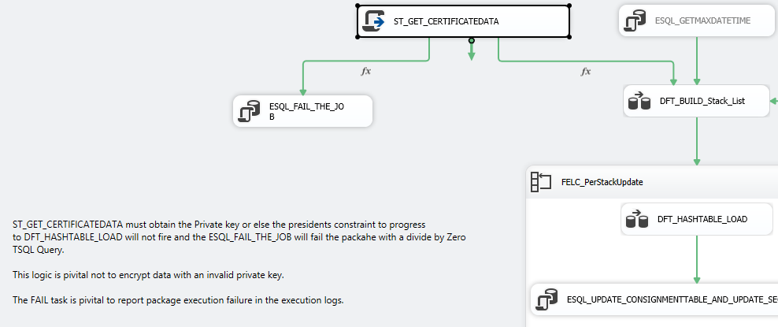
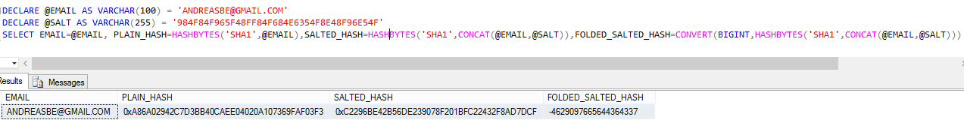
Anonymising data
What is truly anonymized?
How do we protect the secret?!?
How do we retain the Ladder and the clusters of information?
Notes:
Truly anonymized data is data that can not be associated with its non anonymized origin or decrypted/decoded back to its source.
Bad forms: Unsalted Hashes, Native system IDs, Encryption(Pseudo Anonymized), Obfuscation.
Good Forms: Salted Hashes, Folded Salted Hashes.
Remember to wipe the original data (EVERYWHERE)
We protect the secret by not holding the key.
Isolate Development from Security, use encrypted memory space, NEVER WRITE TO DISK!!!!
Use enterprise grade certificates (x.509 key store)

Slide 7
Data sets and quality
Showcase of data (Practical Demo)
Notes:
Talk about cleansing and normalising PII data prior to hashing as a mean of validating clustering and quality
Show Anonymized Data and the importance of Null,

Slide 8
Value and Monetisation
How can the data be monetized?
Notes:
Trend , Benchmark, Price/Volume/Mix (Brand/Consumer)
CSAT Correlation
Predictive Data Analysis
Reactive marketing and targeted advertising

Slide 9
Q&A

